Slide 1


HSE DATABASE MANAGEMENT SYSTEM
Transitioning to Digital Safety
Empowering the Oil and Gas Sector in the Albertine Graben
Presented by: Asiimwe Gilbert (2025/BCS/050/PS)
Institution: Mbarara University of Science and Technology (MUST)
Faculty: Computing and Informatics | Group 5

Slide 2

EXECUTIVE SUMMARY
This project transitions HSE data management from fragmented, paper-based processes into a centralized MySQL Relational Architecture.
Strategic Focus:
Tilenga & Kingfisher Project sites.
NEMA & Petroleum Authority (PAU) Compliance.
Mitigating high-risk operational hazards.

Slide 3





APPLICATION DOMAIN
Incident Management
Audit Tracking
Compliance
Real-time logging of accidents, near-misses, and hazardous observations across remote rig sites.
Scheduling and recording environmental inspections at Buliisa and Hoima operational camps.
Tracking BOSIET and First Aid certifications to ensure 100% field readiness of personnel.
User Groups: HSE Managers, Field Officers, HR Coordinators, and Auditors.

Slide 4


STRATEGIC BENEFITS ANALYSIS
Tangible Gains
Intangible Value
Fines reduction through PAU compliance.
Enhanced corporate reputation in Uganda.
Lower insurance premiums via risk data.
Shift to a proactive "Safety First" culture.
80% reduction in monthly reporting time.
Increased employee trust and morale.

Slide 5
RISK ASSESSMENT & MITIGATION
Technical Connectivity: Remote sites (Buliisa) face intermittent internet. Mitigation: Planned offline-sync capabilities.
Organizational Resistance: Staff accustomed to legacy paper reporting. Mitigation: Localized Swahili/Luganda tooltips.
Data Integrity: "Garbage in, Garbage out" principle. Mitigation: Strict input validation and mandatory fields.
Security Vulnerability: Sensitive medical/incident data. Mitigation: Role-Based Access Control (RBAC).

Slide 6


LOGICAL SYSTEM DESIGN
Relational Entities
The system anchors all activities around the Site entity, branching into:
Site (1:M) Employees: Operational tracking.
Site (1:M) Incidents: Safety history.
Employee (M:N) Training: Resolved via Emp_Training junction table.

Slide 7
PHYSICAL SCHEMA (MYSQL)
Entity | Primary Key | Attributes | Constraints
sites | site_id | site_name, location, risk_level | ENUM('Low', 'Med', 'High')
employees | emp_id | f_name, l_name, role, site_id | FK -> sites(site_id)
incidents | incident_id | date, category, severity, site_id | FK -> sites, FK -> employees
trainings | course_id | course_name, validity_months | NOT NULL

Slide 8

Implementation
MySQL DDL & Data Population

Slide 9





UI & DIALOGUE STRUCTURE
Incident Flow
Reporting
Site Dropdown → Category (LTI, Spill) → Severity → Submit.
Automated SQL aggregation for weekly PAU submissions.
Dashboard
KPI Widgets: Total Incidents, Pending Audits, and Expiring Certs.

Slide 10
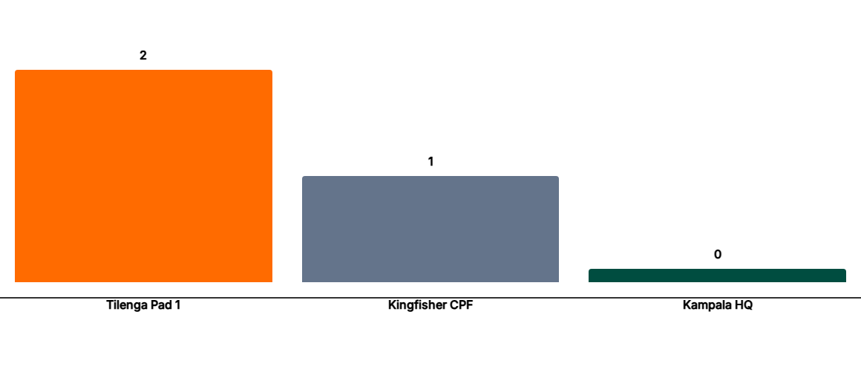
INCIDENT FREQUENCY BY SITE
*Simulated Q4 2025 Data: Identifying high-risk drilling zones for immediate intervention.

Slide 11


TRAINING COMPLIANCE READINESS
Conclusion & Future Scope
The HSE DBMS provides a functional repository for oil sector data. Future expansion includes Offline-First mobile sync and AI Predictive Analytics for hazard forecasting.
Thank You | Asiimwe Gilbert | MUST 2026
92%
30 Days
Current Compliance
Avg. Renewal Window

Slide 12
END
Thank you for your time.
Bibliography
Connolly & Begg (2014). Database Systems: A Practical Approach
PAU (2023). Health, Safety and Environment Regulations.
MySQL 8.0 Reference Manual. dev.mysql.com

